Slide 1

U.S. Supreme Court Review:
The October 2025 Term—A Story in Three Acts
Nevada District Conference | April 29, 2026
Stephen Vladeck | stephen.vladeck@georgetown.edu

Slide 2
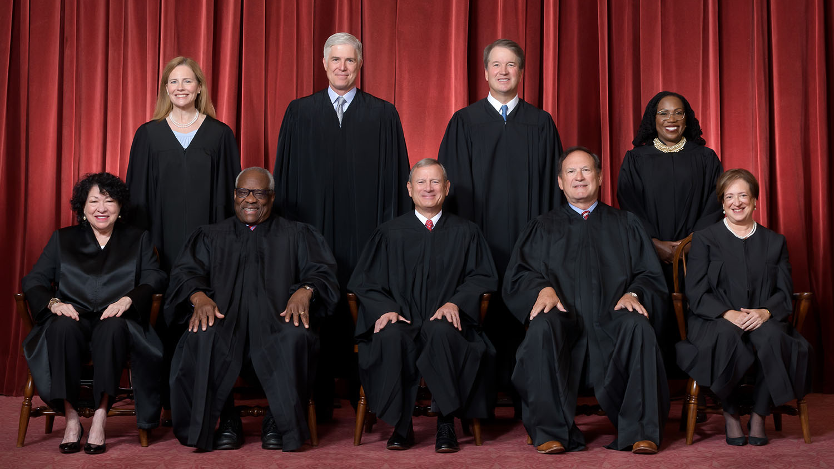

Slide 3

The October 2025 Term, in Three Acts
Just the Facts

Slide 4

OT2025, By the Numbers:
Today is the last (scheduled) day of oral arguments…
23 merits rulings;
34(ish) merits rulings to come.
59 full-Court rulings on emergency apps.;
Only 6 grants so far (but all have been big).

Slide 5
Key Rulings To Date:
Merits Docket
Learning Resources, Inc. v. Trump (2/20)
Chiles v. Salazar (3/10)
Louisiana v. Callais (4/29)
Emergency Docket
Abbott v. LULAC (12/4/25) → Sum. Rev. (4/27)
Trump v. Illinois (12/23/25)
Malliotakis v. Williams (3/2)

Slide 6
Louisiana v. Callais (4/29/2026)
Alito, J: Holds that, to show a violation of section 2 of the Voting Rights Act (and, thus, to justify drawing a majority-minority district), plaintiffs must show not just clear vote dilution, but that the dilution was intended to discriminate.
Kagan, J., dissenting: “I dissent … from this latest chapter in the majority’s now-completed demolition of the VRA.”
Especially after LULAC, and how it approached district-court fact-finding, it’s hard to see what’s left of the VRA…

Slide 7
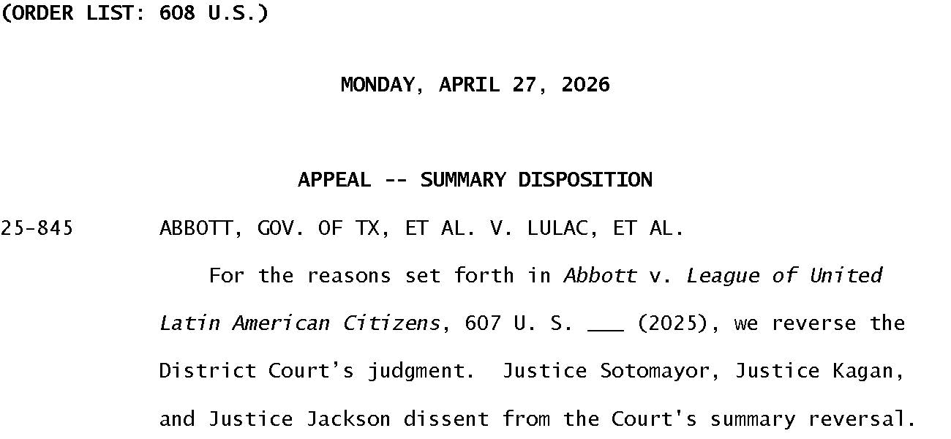

Slide 8
Key Rulings To Come:
Trump v. Slaughter (argued 12/8)
Little v. Hecox | W. Va. v. B.P.J. (argued 1/13)
Trump v. Cook (argued 1/21)
Watson v. RNC (argued 3/23)
Trump v. Barbara (argued 4/1)
Chatrie v. United States (argued 4/27)
Mullin v. Doe (argued today)

Slide 9
Biggest Takeaways from the Merits Docket
OT2025 is going to end up looking much worse for President Trump than OT2024 did—but, as I’ll come back to, that may be a rather significant mirage;
Other than Chatrie, the Court is likely to divide ideologically in every non-Trump major case;
Callais and Slaughter are significantly more important in the long term than anything else; and
Things are not going well inside the building…

Slide 10
Looking Ahead to OT2026…
Only 9 grants so far (this is way behind historically);
Biggest headline is probably the Colorado religious preschool case.
Two predictions:
The Court is going to get a mess of election-related cases; and
There are some really big Trump-related cases on their way, including the circuit split over immigration detention; the Alien Enemies Act; some of the funding-cutoff cases; etc.

Slide 11
The October 2025 Term, in Three Acts
Just the Facts
The Darker Side of OT2025

Slide 12
The Other Headlines from OT2025…
Lower Court Frustration With the Supreme Court
The Court’s Silence About the Attacks on Lower Courts
The New Non-Disclosure Agreements
The Leak of the Clean Power Plan Memos
Justices Attacking Each Other in Public (Sotomayor → Kavanaugh)
Justices Giving … Eye-Opening Speeches (Jackson @ Yale; Thomas @ the University of Texas)

Slide 13
From the New York Times (October 11): “In interviews, federal judges called the Supreme Court’s emergency orders ‘mystical,’ ‘overly blunt,’ ‘incredibly demoralizing and troubling’ and ‘a slap in the face to the district courts.’ One judge compared their district’s current relationship with the Supreme Court to ‘a war zone.’ Another said the courts were in the midst of a ‘judicial crisis.’”

Slide 14
Attacks on the Courts … from the Executive
President Trump has called for the impeachment of judges who rule against him (with help from Senate Judiciary);
Then-Attorney General Bondi filed a (frivolous) judicial misconduct complaint against a sitting judge;
Then-Deputy Attorney General Blanche has described DOJ as being “at war” with the federal courts;
Stephen Miller regularly claims that judges who rule against Trump are part of a “legal insurrection.”

Slide 15
Acting AG Blanche (11/7/25): “There’s a group of judges that are repeat players, and that’s obviously not by happenstance, that’s intentional, and it’s a war, man. . . . We need you, because it is a war, and it’s something we will not win unless we keep on fighting. It’s hard to get the media, it’s hard to get the American people to focus on what a travesty it is when you have an individual judge be able to stop an entire operation or an entire administrative policy that’s constitutional and allowed just because he or she chooses to do so. So, it’s a war.”

Slide 16
Aggrandizing Lower Courts
Abbott v. LULAC: Majority runs right over detailed district court fact-finding about racial gerrymandering;
Malliotakis v. Williams: For the first time … ever, majority grants emergency relief to block a state trial court ruling before state supreme court had a chance to consider emergency relief on the merits;
Five different cases with grants of certiorari before judgment (26 since 2/2019 after 0 from 8/2004–2/2019).

Slide 17
The October 2025 Term, in Three Acts
Just the Facts
The Darker Side of OT2025
The Deeper Tension of OT2025

Slide 18
How to Understand the Current Court
The Court and President Trump
The Court and Executive Power
The Court and Lower Courts
The problem arises from how these three phenomena intersect—how the Court’s behavior is, in some pretty significant ways, kneecapping the ability of lower courts to push back against a lot of government lawlessness.

Slide 19
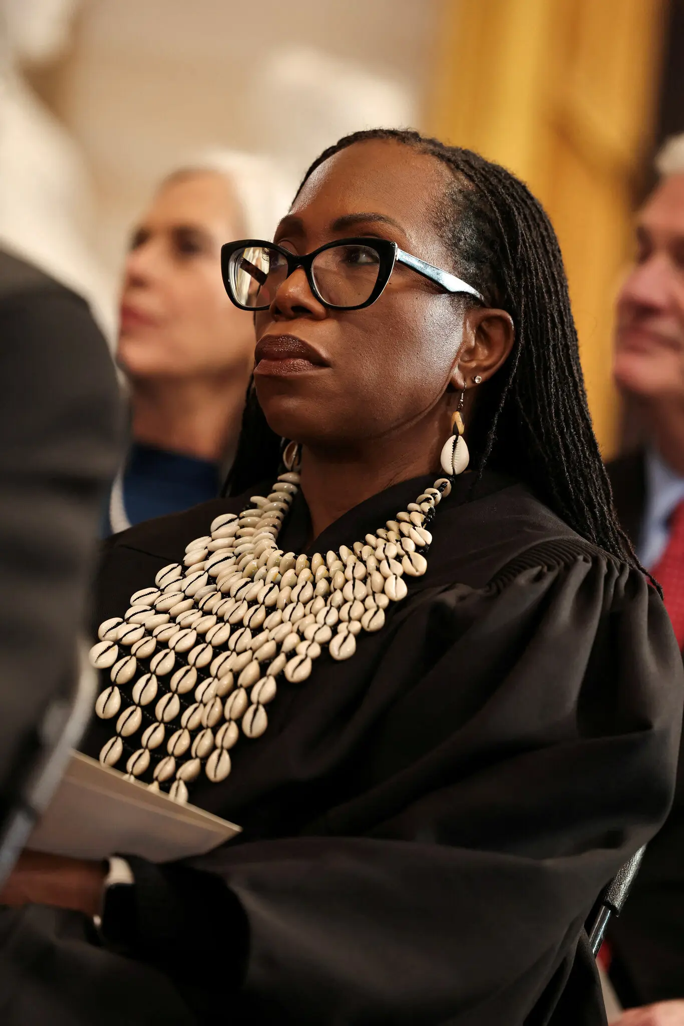
“Perhaps the degradation of our rule-of-law regime would happen anyway. But this Court’s complicity in the creation of a culture of disdain for lower courts, their rulings, and the law (as they interpret it) will surely hasten the downfall of our governing institutions, enabling our collective demise.” — Trump v. CASA, Inc., 606 U.S. 831, 941 (2025) (Jackson, J., dissenting)

Slide 20
Examples of Where Courts Have Failed…:
Immigration Detention / Defiance
ICE Misbehavior
Appropriations / Civil Service Abuses
Prof. Baude: “[E]ven if you wanted the court to maximally stop the Trump administration, surely it would need to pick and choose its spots carefully. There’s just too much lawlessness to do otherwise.”

Slide 21
The Upshot(s)
Despite outward appearances, this is not an ordinary Supreme Court Term;
Despite outward appearances, even a series of “losses” for the Trump administration will not be some kind of marker that the Court has somehow pivoted; and
If and when we talk about Court reform, an important part of the conversation will be how to restore power to lower courts / increase accountability going forward.

Slide 22


https://stevevladeck.substack.com
stephen.vladeck@georgetown.edu

